Slide 1
Python Basic Concepts and Programming
Module 1
3rd Semester MCA
SDIT

Slide 2
Python programming language
Python is an example of a high-level language as C, C++, Java.
Also low-level languages, i.e, “machine lang” or “assembly lang.”
There are multiple IDEs (Integrated Development Environment) available for working with Python. Some of them are PyCharm, LiClipse, IDLE, Jupyter, Spyder etc.
The basic Python can be downloaded from the link: https://www.python.org/downloads/
Python has set of libraries for various purposes like large-scale data processing, predictive analytics, scientific computing etc.
Based on one’s need, the required packages can be downloaded. Free open source : Anaconda
https://anaconda.org/anaconda/python

Slide 3
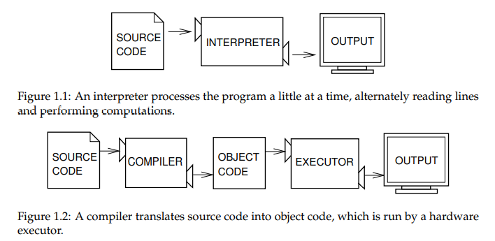
Interpreter and compiler

Slide 4
Two kinds of programs process high-level languages into low-level languages: interpreters and compilers
A compiler reads the program.
Translates it completely before the program starts running.
High-level program is called the source code. Translated program is called the object code or the executable.

Slide 5
Interactive mode and Script mode.
There are two ways to use the interpreter:
In interactive mode, you type Python programs and the interpreter displays the result:
>>> 1 + 1
2
>>> print(4)
4
>>> message = 'And now for something completely different'
>>> n = 17
>>> pi = 3.1415926535897931
Alternatively, you can store code in a file and use the interpreter to execute the contents of the file, which is called a script. By convention, Python scripts have names that end with .py.

Slide 6
SOME FUNDAMENTALS
Whitespace is significant in Python. Where other languages may use {} or (), Python uses indentation to denote code blocks.
Comments:
• Single-line comments denoted by #.
• Multi-line comments begin and end with three ‘’’.
• Typically, multi-line comments are meant for documentation.
• Comments should express information that cannot be exp

Slide 7
PYTHON TYPING
Python is a strongly, dynamically typed language.
Strong Typing
Obviously, Python isn't performing static type checking, but it does prevent mixing operations between mismatched types.
Explicit conversions are required in order to mix types.
Example: 2 + "four" not going to fly
Dynamic Typing
All type checking is done at runtime.
No need to declare a variable or give it a type before use.
Let's start by looking at Python's built-in data types.

Slide 8
NUMERIC TYPES
The subtypes are int, long, float and complex.
Their respective constructors are int(), long(), float(), and complex().
All numeric types, except complex, support the typical numeric operations you'd
expect to find (a list is available here). Mixed arithmetic is supported, with the
"narrower" type widened to that of the other. The same rule is used for mixed
comparisons.
* Numeric
int: equivalent to C's long int in 2.x but unlimited in 3.x.
float: equivalent to C's doubles.
long: unlimited in 2.x and unavailable in 3.x.
complex: complex numbers..
Supported operations include constructors (i.e. int(3)), arithmetic,
negation, modulus, absolute value, exponentiation, etc.

Slide 9
SEQUENCE DATA TYPES
There are seven sequence subtypes: strings, Unicode strings, lists, tuples, bytearrays, buffers, and xrange objects.
All data types support arrays of objects but with varying limitations.
The most commonly used sequence data types are strings, lists, and tuples. The xrange data type finds common use in the construction of enumeration-controlled loops. The others are used less commonly.
range() – takes more memory as it keeps the entire lists of elements in memory. xrange functionality is implemented range() in 3.x
xrange() – takes less memory as it keeps only one element at a time in memory. Exist only in 2.x

Slide 10
SEQUENCE TYPES: UNICODE STRINGS
Unicode strings can be used to store
and manipulate Unicode data.
As simple as creating a normal string (just put a 'u' on it!).
Use Unicode-Escape encoding for special
characters.
Also has a raw mode, use 'ur' as a prefix.
To translate to a regular string, use the
encode() method.
To translate from a regular string to
Unicode, use the unicode() function.

Slide 11
myunicodestr1 = u"Hi Class!"
myunicodestr2 =
"Hi\u0020Class!“
print myunicodestrl, myunicodestr2
newunicode =u'\xe4\xf6\xfc'
print newunicode
newstr = newunicode.encode('utf-8')
print newstr
print unicode (newstr, 'utf-8')
Output:
Hi Class! Hi Class!
äöu
äöü
äöü

Slide 12
SEQUENCE TYPES: LISTS
Lists are an incredibly useful compound data type.
Lists can be initialized by the constructor, or with a bracket structure containing or more elements.
Lists are mutable - it is possible to change their contents. They contain the additional mutable operations.
Lists are nestable.
Feel free to create lists of lists of lists

Slide 13
mylist = [42, 'apple', ufunicode apple', 5234656]
print mylist
mylist [2] = 'banana'
print mylist
mylist [3] = [['iteml', 'item2 ['item3', 'item4']]
print mylist
mylist.sort ()
print mylist
print mylist.pop()
mynewlist = [x*2 for x in range (0,5)]
print mynewlist
Output:
(42. 'apple', u'unicode apple, 5234656)
(42, 'apple', banana, 5234656)
(42, apple, banana', [[item1", item21, [item, tem
[42, [[item1", "item2] [item3, item4] apple banana)

Slide 14
SEQUENCE TYPES: STRINGS
Created by simply enclosing characters in either single-or double-quotes.
It's enough to simply assign the string to a variable.
Strings are immutable.
There are a tremendous amount of built-in string-methods (listed here)
mystring "Hi, I'm a string!“

Slide 15
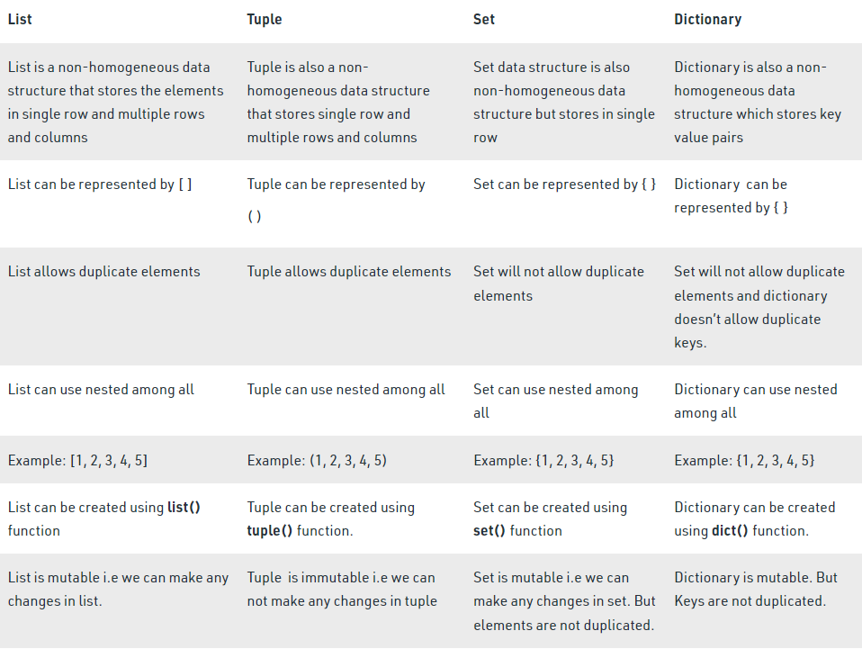
List , Tuple, Set, Dictionary

Slide 16
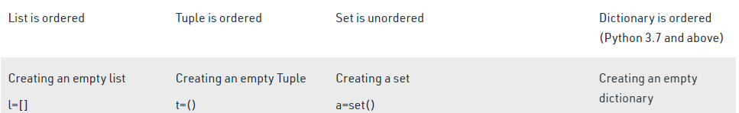
T=[]
t=()
b=set(a)
d={}

Slide 17

Variables, Expressions and Statements
A variable is a named place in the memory.
Stores data.
Data is used using the variable “name”.
An assignment statement creates new variables.
The type of it will be decided by the value assigned to it.
Values and types :
A value is basic things, like a letter or a number.
i.e, 1, 2, and 'Hello, World!'.
These values belong to different types:
2 is an integer,
'Hello, World!' is a string,

Slide 18
Cont.
Rules to follow when naming the variables.
Variable names can contain letters, numbers, and the underscore.
Variable names cannot contain spaces and other special characters.
Variable names cannot start with a number.
Case matters—for instance, temp and Temp are different.
Keywords cannot be used as a variable name.
Valid variable names are: Spam, eggs, spam23 ,_speed
Underscore character (_) can appear in a name. Ex: my_first_variable .
As Python is case-sensitive, variable name sample is different from SAMPLE .
invalid variable
>>> 76trombones = 'big parade‘ >>> more@ = 1000000 >>> class = 'Advanced'

Slide 19
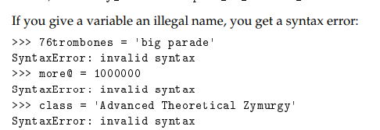
Variables
>>> message = 'And now for something completely different'
>>> n = 17
>>> pi = 3.1415926535897932
The type of a variable is the type of the value it refers to.
>>> type(message)
<type ‘str’>
>>> type(n)
<type ‘int’>
>>> type(pi)
<type ‘float’>

Slide 20
Python 2 has 31 keywords:
and
del
from
not
while
as
elif
global
or
with
assert
else
if
pass
yield
break
except
import
print
class
exec
in
raise
continue
finally
is
return
def
for
lambda
try
In Python 3, exec is no longer a keyword, but nonlocal is

Slide 21
import datetime x = datetime.datetime.now() print(x)
****************************
from datetime import time x = time(hour=15) print(x)
****************************
import calendar as c
print(c.month_name[1])
****************************
def myfunction(): global x x = "hello“
****************************
x = -1 if x < 0: raise Exception("Sorry, no numbers below zero")
****************************
x = "hello” #if condition returns True, then nothing happens:
assert x == "hello“ #if condition returns False, AssertionError is raised:
assert x == "goodbye“
assert x == "goodbye", "x should be 'hello'“

Slide 22
imports : specific module
from : It imports specific parts of a module
assert : used when debugging code
We can write a message to be written if the code returns False
pass :
placeholder for future code.
When the pass statement is executed,
Nothing happens,
Avoid getting an error when empty code is not allowed.
Empty code is not allowed in:
loops,
function definitions,
class definitions,
or in if statements.

Slide 23
Statements and Expressions
A statement is a unit of code that the Python interpreter can execute.
assignment statement
It consists of an expression on the right-hand side and a variable to store the result
multiple assignments : a, b, c = 2, “B”, 3.5
print statement
print is a function.
Takes string or variable as a argument to display.
>>> x=5 #assignment statement
>>> x=5+3 #assignment statement
>>> print(x) #printing statement
Optional arguments with print statement:
sep : separator
end : advance to the next line
print("a","b","c","d",sep=";")
a;b;c;d

Slide 24
Expressions
combination of values, variables, and operators
legal expressions
>>> x=5
>>> x+1
6
print("A“)
print("B")
print("C", end=" ")
print("E")
O/P:
A
B
C E

Slide 25
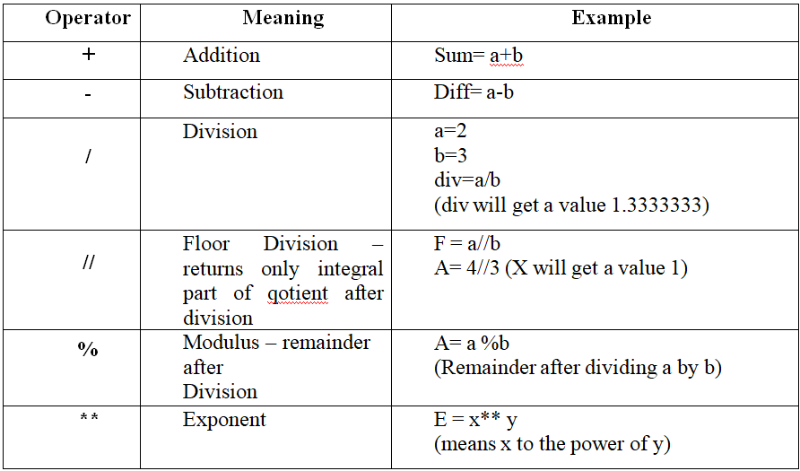
Operators, Precedence and Associativity
It represent computations like addition and multiplication.
The values the operator is applied to are called operands.

Slide 26
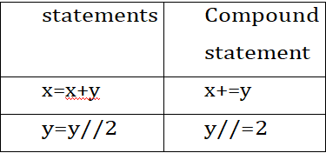
Relational or Comparison Operators:
Less than, Greater than etc, between two operands.
It return a Boolean value either True or False.
Assignment Operators:
Assignment operator =, is used for assigning values to
variables.
Logical Operators:
and, or, not are used for comparing or negating the logical values
And:
Ex1 :>>> x=5
>>> x>0 and x<10
True
Ex2: >>> x= -5
>>> x>0 and x<10
False
Or :
>>> n=2
>>>n%2==or n%3==0
True
Not:
>>> x=5
>>> x> 0 and x<10
True
>>> not x
False

Slide 27
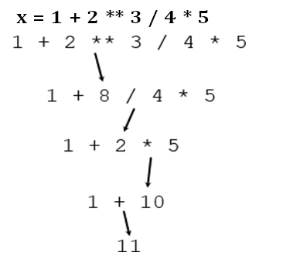
Precedence and Associativity (Order of operations)
Operators are special symbols that represent computations like addition and multiplication.
The values the operator is applied to are called operands.
The operators +, -, *, / and ** perform addition, subtraction, multiplication, division and exponentiation, as in the following examples:
20+32
hour-1
hour*60+minute
minute/60
5**2
(5+9)*(15-7)

Slide 28
Order of operations: PEMDAS easy to remember rules:
Parentheses have the highest precedence and can be used to force an expression to evaluate in the order you want
Exponentiation has the next highest precedence
Multiplication and Division have the same precedence, which is higher than Addition and Subtraction,
Operators with the same precedence are evaluated from left to right (except exponentiation).

Slide 29
Data Types, Indentation, Comments
Basic data types of Python are
Numbers
Boolean
Strings
list
tuple
dictionary
None

Slide 30
Number:
Integers, floating point numbers and complex numbers
They are defined as int, float and complex class in Python
Boolean
conditional statements
Boolean value is, either True or False
Strings
A sequence of one or more characters
Include letters, numbers, and other types of characters.
Multiline strings
denoted using triple quotes, ''' or " " “
>>> s = 'This is single quote string'
>>> s = "This is double quote string"
>>> s = '''This
is Multiline
string'''
Lists
All the items (elements) inside square brackets [ ]
Separated by commas
Tuple
An ordered collection of Python objects.
Immutable , can’t be modified after it’s created
we can represent tuples using parentheses ( )

Slide 31
Dictionary
An unordered collection of data values.
consists of key-value pair
Key-value is provided within the dictionary to form it more optimized.
Each key-value pair is separated by a colon(:),whereas each key’s separated by a ‘comma’.
Example: Dict1 = {1 : 'Hello' , 2 : 5.5, 3 : 'World' }
None
None is another special data type in Python.
None is frequently used to represent the absence of a value.
For example, >>> money = None

Slide 32
Indentation
Programs get structured through indentation
In Python it is a requirement and not a matter of style.
Any statements written under another statement with the same indentation is interpreted to belong to the same code block
Nested statements need to be indented further to the right.
Comments
Ex1. #This is a single-line comment
Ex2. ''' This is a multiline
comment '''

Slide 33
Reading Input
Built-in function called input
Gets input from the keyboard
\n at the end of the prompt represents a newline
>>> inp = input()
Welcome to world of python
>>> print(inp)
Welcome to world of python
>>>x=input('Please enter some text:\n')
Please enter some text:
Roopa
>>> print(x)
Roopa
user to type an integer,
try to convert the return value to int using the int() function
>>> x=int(input('enter number\n'))
enter number
12

Slide 34
Print Output
Format operator
The following example uses “%d” to format an integer, “%g” to format a floating point number, and “%s” to format a string:
camels = 42
'%d' % camels
'I have spotted %d camels.' % camels'I have spotted 42 camels.'
Format function : string formatting methods string formatting methods
positional_argument :
It can be integers, floating point numeric constants, strings, characters and even variables.
keyword_argument :
A variable storing some value, which is passed as parameter.
Positional arguments are placed in order :
Can Reverse the index nnumbers
If arguments not specified
>>>print("{0} college{1} department".format("SDIT",“MCA"))
SDIT college MCA department
>>>print("{ } college{ } department".format("SDIT",“MCA"))
SDIT college MCA department
>>>print(“MCA department {0} ‘A’ .format(“1", college="SDIT"))
MCA department 1’A’ section SDIT

Slide 35
Formatted String Literals
import math
print(f'The value of pi is approximately {math.pi:.3f}.')
bugs = 'roaches'
count = 13
area = 'living room'
print(f'Debugging {bugs=} {count=} {area=}')
#Use "+" to always indicate if the number is positive or negative:
txt = "The temperature is between {:+} and {:+} degrees celsius."
print(txt.format(-3, 7))
#Use "_" to add a underscore character as a thousand separator:
txt = "The universe is {:_} years old."
print(txt.format(13800000000))
https://www.w3schools.com/python/ref_string_format.asp

Slide 36
String format() Method
print('We are the {} who say "{}!"'.format('knights', 'Ni'))
Positional argument :
print('{0} and {1}'.format('spam', 'eggs'))
print('{1} and {0}'.format('spam', 'eggs'))
print('{} and {}'.format('spam', 'eggs'))
Keyword argument:
print('This {food} is {adjective}.'.format(food='spam', adjective='absolutely horrible'))
Positional and keyword arguments
print('The story of {0}, {1}, and {other}.'.format('Bill', 'Manfred',other='Georg'))

Slide 37
Type Conversions, The type( ) Function and Is Operator
Type Conversions
int can convert ﬂoating-point values to integers,
but it doesn’t round oﬀ; it chops oﬀ the fraction part.
float converts integers and strings to ﬂoating-point numbers.
str converts its argument to a string.
The type( ) Function
type function is called to know the datatype of the value.
The expression in parenthesis is called the argument of the function.
The argument is a value or variable that we are passing into the function as input to the function.
>>> type(33)
<class 'int'>
Is Operator
If we run these assignment statements:
>>> a = 'banana'
>>> b = 'banana'
>>> a is b
True

Slide 38
When two variables are referring to same object, they are called as identical objects.
When two variables are referring to different objects, but contain a same value, they are known as equivalent objects.
>>>s1=input(“Enter a string:”)
>>>s2= input(“Enter a string:”)
>>>s1 is s2 #check s1 and s2 are identical
False
>>>s1 == s2 #check s1 and s2 are equivalent
True
Here s1 and s2 are equivalent, but not identical
x = str(3) # x will be '3‘
y = int(3) # y will be 3
z = float(3) # z will be 3.0

Slide 39
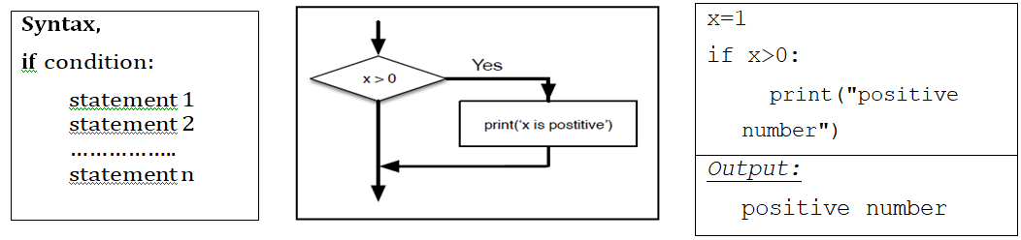
Control Flow Statements
The if Decision Control Flow Statement

Slide 40
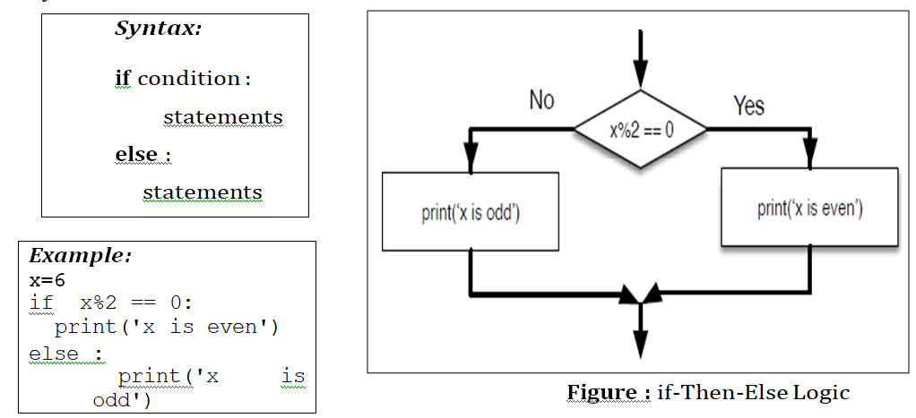
if…else Decision Control Flow Statement (alternative execution)

Slide 41
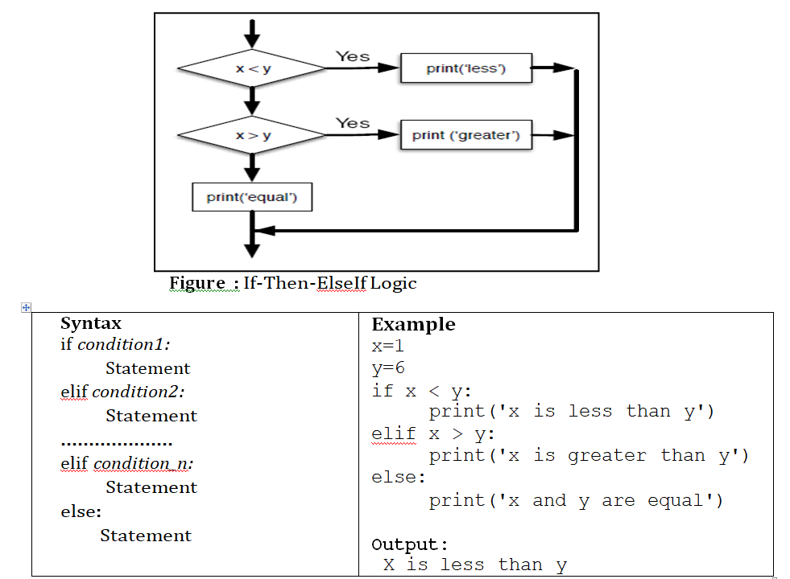
The if…elif…else Decision Control Statement (Chained conditionals)

Slide 42
Nested if Statement
Example
x=3 y=4
if x == y:
print('x and y are equal') else:
if x < y:
print('x is less than y') else:
print('x is greater than y')
Output:
x is less than y

Slide 43
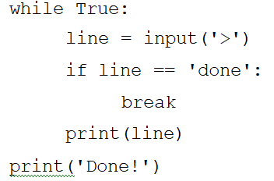
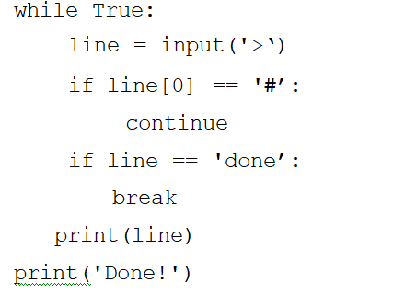
ITERATION
The while statement
The syntax of while loop :
while condition:
block_of_statements
statements after the loop
EX: i = 1
while i<=5:
print(i) i= i+1
print(“ printing is done”)
Inﬁnite loops with break
The break statement can be used to break out of a for or while loop before the loop is ﬁnished.
Finishing iterations with continue
the continue statement skips to the next iteration without ﬁnishing the body of the loop for the current iteration.

Slide 44
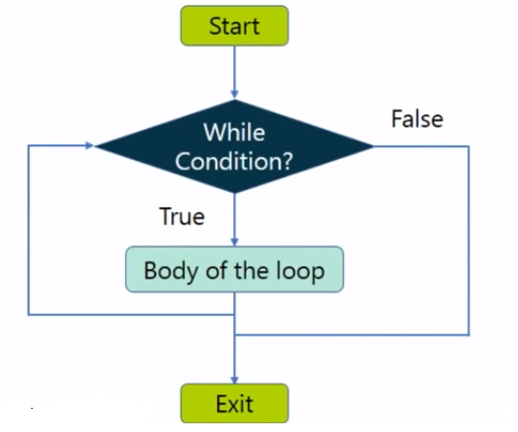

Slide 45
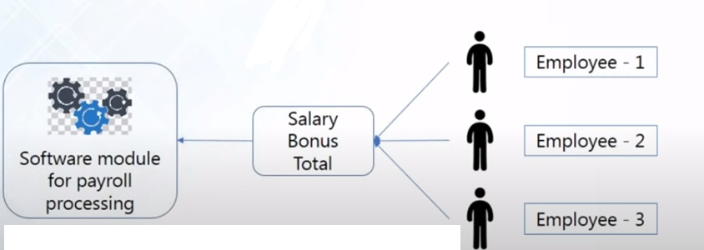
Example pay roll

Slide 46
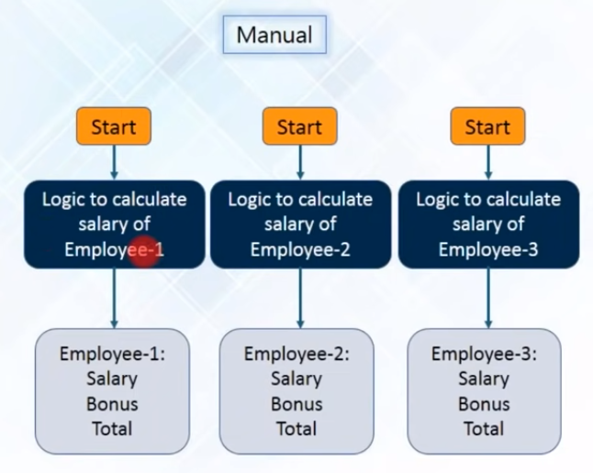

Slide 47
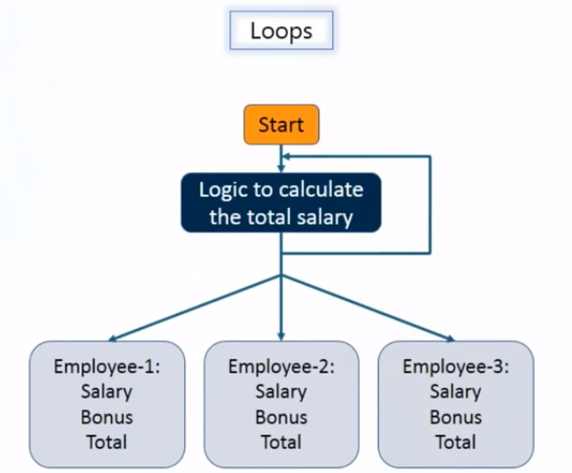

Slide 48
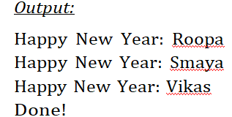
Deﬁnite loops using for
for loop with sequence
for loop with range( ) function
Syntax of for loop with sequence:
for var in list/sequence :
statements to be repeated
friends = ['Roopa', 'Smaya', 'Vikas’]
for name in friends:
print('Happy New Year:', name)
print('Done!')
for i in "Hello":
print(i, end=‟\t‟)

Slide 49
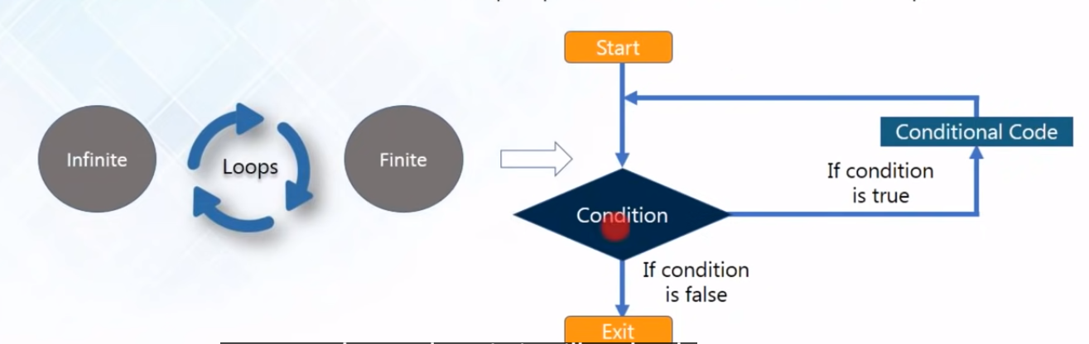

Slide 50
Syntax of for loop with range( ) function:
for variable in range( start, end, steps):
statements to be repeated
for i in range(5):
print(i, end= “\t”) 0 1 2 3 4
for i in range(3,0,-1):
print(i) 3
print('Blast off!!') 2
1
Blast off!!

Slide 51
Ex:
words=[“John”,”Sam”,”Sham”]
for w in words:
print(w) # for len of words print(len(w))
OR
for w in words.items:
print(w)
range() Method returns length of list elements
for i in range(len(words)):
print(i, words[i]) #To display words use print(words[i])

Slide 52
Ex. Cont.
for i in reversed(range(1, 10, 2)):
... print(i)
basket = ['apple', 'orange', 'apple', 'pear', 'orange', 'banana']
for i in sorted(basket):
... print(i)
basket = ['apple', 'orange', 'apple', 'pear', 'orange', 'banana']
for f in sorted(set(basket)):
... print(f)

Slide 53
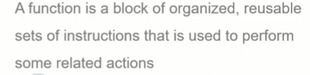
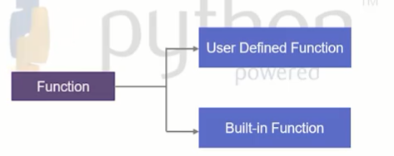
What are functions?

Slide 54
Syntax :
def function_name(parameters):
statement(s)

Slide 55
Functions in python
Function definition:
every function should start with “def” keyword
Name of the function
Parameters/arguments(optional)
Function name should end with :
Return (empty or value)
Multi value return can done(using tuples)
Call by Reference Parameters is implemented
It behaves like any other object such as an int or a list.

Slide 56
Comparision of function usage
public int add(int a, int b)
{
int sum=0;
sum = a+b;
return sum;
}
def add(a,b):
sum=0
sum=a+b
return sum

Slide 57
Function call
Function name
Arguments and parameters

Slide 58
Functions
A sequence of instructions intended to perform a specific independent task is known as a function.
You can pass data to be processed, as parameters to the function. Some functions can return data as a result.
In Python, all functions are treated as objects, so it is more flexible compared to other high- level languages.
In this section, we will discuss various types of built-in functions, user-defined functions, applications/uses of functions etc.

Slide 59
Ex:
def print_greeting():
print “Hello!”
print “How are you today?”
print_greeting() #Calling the function

Slide 60
Ex:
def hello_func(name,somelist):
print “Hello,”,name,”!\n”
name = “Caitlin”
somelist[0]=3
return 1, 2
myname=“Ben”
mylist=[1,2]
a,b= hello_func(myname,mylist)
print myname,mylist
print a,b

Slide 61
Ex:
If the python interpreter is running the module as the main program, it sets the special variable
i.e __name__ = “__main__”. This allows flexibility in writing your module.
__name__ is another built ins, has two underscores on either side!
if __name__ == “__main__”
print (even_fib())

Slide 62
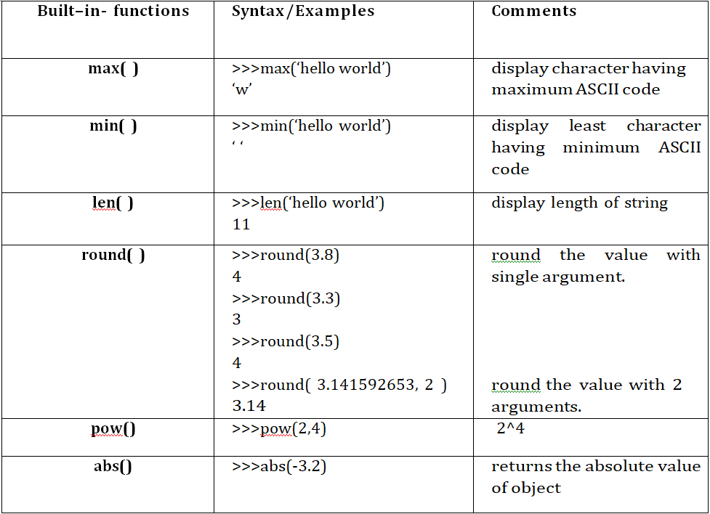
Function types
Built in functions

Slide 63
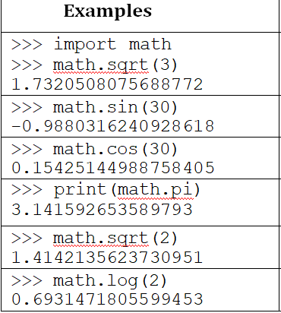
Commonly Used Modules
Math functions

Slide 64
Function Definition and Calling the Function
Python facilitates programmer to define his/her own functions.
The function written once can be used wherever and whenever required.
The syntax of user-defined function would be:
def fname(arg_list):
statement_1
statement_2
……………
statement_n
return value

Slide 65
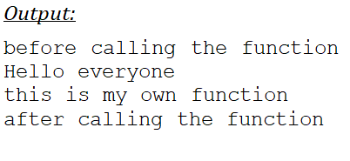
def myfun():
print("Hello everyone")
print("this is my own function")
print("before calling the function")
myfun() #fuction call
print("after calling the function")
Function calls
A function is a named sequence of instructions for performing a task.
Whenever we want to do that task, a function is called by its name
>>> type(33)
<class 'int'>

Slide 66
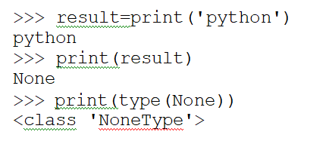
The return Statement and void Function
A function that performs some task, but do not return any value to the calling function is known as void function
The function which returns some result to the calling function after performing a task is known as fruitful function.
def addition(a,b): #function definition
sum=a + b
return sum
x=addition(3, 3) #function call
print("addition of 2 numbers:",x)
Output:
addition of 2 numbers:6

Slide 67
Conti.
Fruitful functions:
a functions returns a value.
Void functions:
a function that always returns None.

Slide 68
Types of arguments in function
Required arguments
Keyword arguments
Default arguments
Variable length arguments

Slide 69
Required arguments
Same and order
Example:
#example for required arguments
def display(num1,num2):
print(num1,num2)
display(100,200)

Slide 70
Keyword arguments
Oder or position is not required
Initialization done base of keywords
Example:
#expample for keyword arguement
def display(num1,num2):
print(num1,num2)
display(num2=10, num1=20)

Slide 71
Default arguments
Number of argument need not be same
Some of arguments will be consider as default
Example:
#example for default arguments
def display(name, course="MCA"):
print(name)
print(course)
display(name="robert", course="BCA")
display(name="rishab")

Slide 72
Ex:
def print_message():
print(“Hi, how are you\n”)
print(“Have a nice day\n”)
def repeat_message():
print_message()
print_message()
repeat_message()

Slide 73
# Python code to demonstrate call by value
string = "Geeks"
def test(string):
string = "GeeksforGeeks"
print("Inside Function:", string)
# Driver's code
test(string)
print("Outside Function:", string)
# Python code to demonstrate call by reference
def add_more(list):
list.append(50)
print("Inside Function", list)
# Driver's code
mylist = [10,20,30,40]
add_more(mylist)
print("Outside Function:", mylist)

Slide 74
def swap(s1, s2):
tmp = s1
s1 = s2
s2 = tmp
return s1,s2
s1 = 1
s2 = 2
print(“Before Swap :”, s1,s2)
s1,s2=swap0(s1, s2)
print(“After Swap :”, s1,s2)

Slide 75
Default Parameters
parameters optional and use default values
If user does not want to provide values for some arg. This is done with the help of default argument values
Parameters by appending to the parameter name in the function definition the assignment operator ( = ) followed by the default value.(Constant value)
def say(message, times=1):
print(message * times)
say('Hello')
say('World', 5)
Keyword Arguments
Some functions with many parameters
To specify only some of them, then you can give values for such parameters by naming them.
def func(a, b=5, c=10):
print('a is', a, 'and b is', b, 'and c is', c)
func(3, 7)
func(25, c=24)
func(c=50, a=100)

Slide 76
Global vs. Local variables
Local variables can be accessed only inside the function in which they are declared.
Global variables can be accessed throughout the program body by all functions.
total = 0 # This is global variable. # Function definition is here
def sum( arg1, arg2 ):
total = arg1 + arg2 # Here total is local variable.
print("Inside the function local total : ", total)
return total
sum( 10, 20 ); # Now you can call sum function
print("Outside the function global total : ", total)
Output :
Inside the function local total : 30
Outside the function global total : 0

Slide 77
*args and **kwargs, Command Line Arguments
pass a variable number of arguments to the calling function
*args -allows you to pass a non-keyworded variable length tuple
**kwargs - you to pass keyworded, variable length dictionary
def total(a=5, *numbers, **phonebook):
print('a', a) #iterate through all the items in tuple
for single_item in numbers:
print('single_item', single_item) #iterate through all the items in dictionary
for first_part, second_part in phonebook.items():
print(first_part,second_part)
total(10,1,2,3,Jack=1123,John=2231,Inge=1560)

Slide 78
Cont.
Command Line Arguments
The sys module provides a global variable named argv
C:\Code>python sqrtcmdline.py 2 5
from sys import argv
for n in range(int(argv[1]), int(argv[2]) + 1):
print(n, sqrt(n))

Slide 79
Assignment Questions
Define python? Write a short note on data types in Python.
Explain the syntax of the conditional statements and for loop with an example
Explain the fruitful and void functions? Give examples. Create a python program for calculator application using functions.
Define function. Explain the built-in functions and commonly used functions
Differentiate between local and global variables with suitable examples.

